Slide 1
On the Analysis of the Zeus Botnet Crimeware Toolkit
H. Binsalleeh, T. Ormerod, A. Boukhtouta, P. Sinha, A. Youssef, M. Debbabi, and L. Wang
Presented by Anh Ho

Slide 2
Overview
What is Zeus?
Who are the Researchers?
What did they find?
Conclusion
Questions?

Slide 3
What is Zeus?
Botnet for hire
“King of the Underground Crimeware Toolkits”
Symantec
3.6 million US infections
Damballa, July 2009
User friendly Interface
Competitive price

Slide 4
The Researchers
National Cyber Forensics and Training Alliance Canada
Computer Security Laboratory, Concordia University

Slide 5
Command and Control Server
Control Panel
PHP scripts to monitor the botnet
MySQL Database
Collects the stolen information for the botmaster

Slide 6
Different Parts of Zeus
Config.txt
Configuration file
Webinjects.txt
List of websites and injection rules
Config.bin
Encrypted configuration parameters
Bot.exe
Malicious binary customized to the C&C server

Slide 7
Zeus Builder
Building the Configuration File Functionality
Encoding clear text configurations
RC4 encryption
Building the Malware Binary File Functionality
Building the customized malware binary
Reads from the config file for parameters
Malware Infection Removal Functionality
Determines the presence of Zeus and removes it
Checks specific registry keys and files

Slide 8
Files Created During Infection

Slide 9
Communications Pattern
Infected Client sends a GET /config.bin to the C&C
C&C gives the encrypted config.bin file
Client Receives and decrypts it
The key is embedded inside bot.exe
The bot reports to the C&C through POST /gate.php

Slide 10
Communications Pattern Cont.

Slide 11
De-obfuscation Process
Round 1
4 byte decryption key, 1 byte seed
Decrypts a section from Text/Code and writes it into virtual memory

Slide 12
De-obfuscation Process Cont.

Slide 13
De-obfuscation Process Cont.
Round 2
Copies two binary blocks from Text/Code
Concatenates them
Writes it into virtual memory
Fills “holes” or zero bytes with filler text

Slide 14
De-obfuscation Process Cont.

Slide 15
De-obfuscation Process Cont.
Round 3
Decrypts the output of the second de-obfuscation with the 8 byte key by XOR

Slide 16
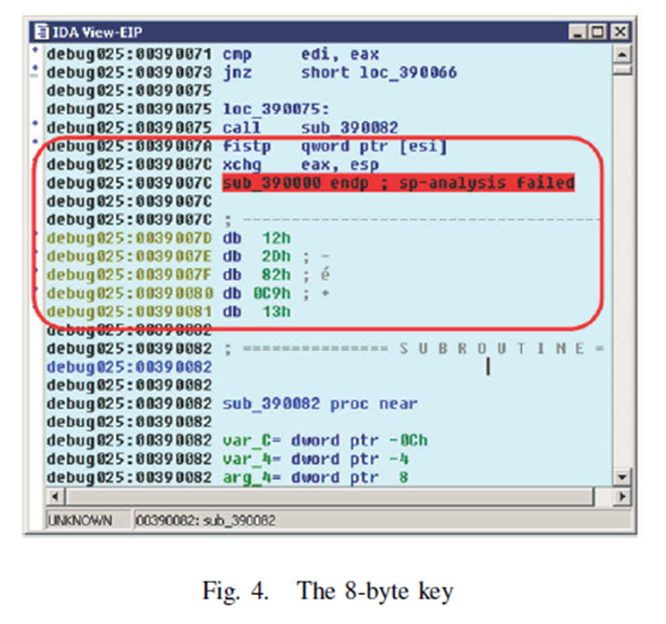
De-obfuscation Process Cont.

Slide 17
De-obfuscation Process Cont.
Round 4
Uses the previously decrypted bytes to modify the rest of the Text/Code

Slide 18
Installation De-obfuscation
Transforms arbitrarily long strings into readable text
Round 1
De-obfuscates DLL libraries and function names
Round 2
Decrypts URLs in the configuration file

Slide 19
Installation De-obfuscation Cont.

Slide 20
Installation Process
Loads the LoadLibrary and GetProcAddress from Kernel32.dll
Decrypts strings shown before
LoadLibrary and GetProcAddress loads more methods from the Windows DLLs
Checks the process table for Outpost.exe (Agnitum Security)
Checks for zlclient.exe (Zonelabs Internet Security)

Slide 21
Installation Process Cont.
Appends path
C:/Windows/System32/sdra64.exe to HKEY_LOCAL_MACHINE/SOFTWARE/Microsoft/WindowsNT/CurrentVersion/Winlogon/Userinit
Allows for persistence on startup
Injects the Zeus binary into the virtual memory of winlogon.exe

Slide 22
On First Installation
Makes a copy of itself and stores it in:
C:/Windows/System32/sdra64.exe
Evades signature detection by appending random bytes to the end
Duplicates the Modification, Access, and Creation times to alter it’s creation date

Slide 23
First Installation Cont.
Creates a folder at:
C:/Windows/System32/lowsec
Two new files:
User.ds
Stores the dynamic config file
Local.ds
Stores the stolen information until ready to send to the drop location

Slide 24
List of Zeus Malware Commands

Slide 25
Conclusion
Designed a tool for the automated recovery of the encryption key
Able to inject falsified information into the botnet in order to defame the business model

Slide 26
Questions?

